Slide 1
Hotel Bookings
By: Brian Chun, Savin Damkar, Hasnu Kwatra

Slide 2
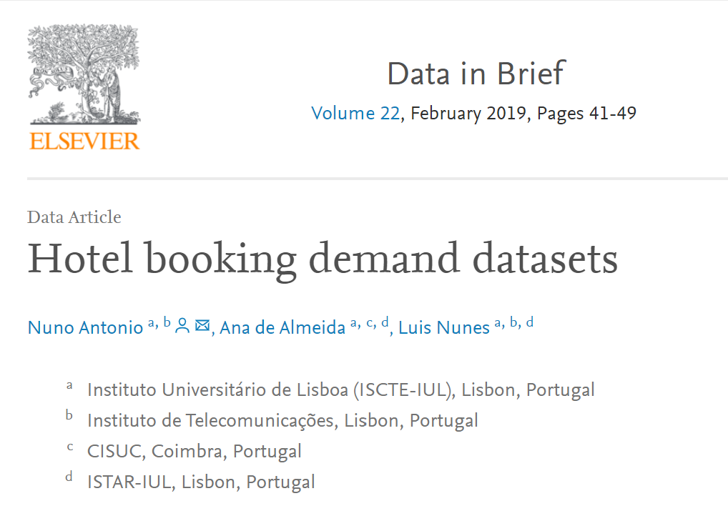
Synopsis
Original data from hotels
Published in a publication
Objective of Study
Potential applications in other industries
Notes:
Used in a publication (Data in brief)
Data comes from real hotels in Portugal: a resort hotel in Algarve and a city hotel in Lisbon, was taken between the 1st of July of 2015 and the 31st of August 2017
Intention was developing models for predicting the likelihood of a cancellation occuring
Potential applications in developing further models: tourism, hospitality, cruises, theme parks, etc.

Slide 3
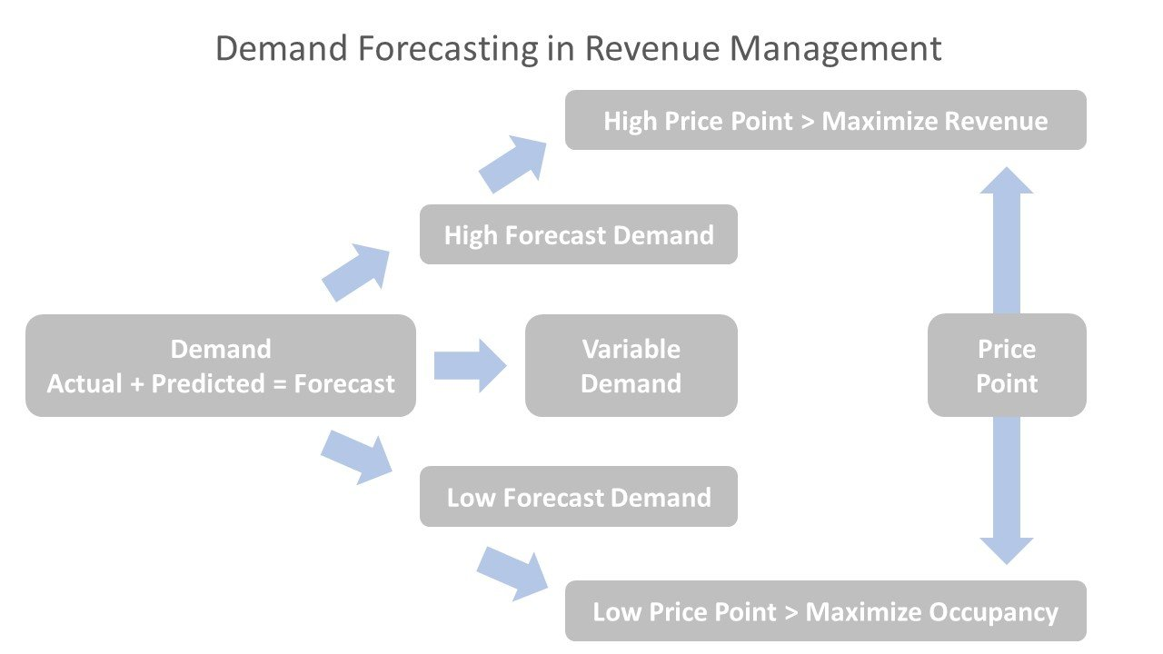
Motivation
Cancellations: understanding demand
Larger goal in application
Revenue Management
Examining best model
Notes:
-By understanding demand, we can understand conditions affecting cancellations more thoroughly. -We can however also use this in a larger application known as revenue management. In this we can adjust pricing given demand trends and set budgets accordingly. Airlines already do this in conjunction with overbooking flights. By applying this to hotel bookings, it is our hope that we can apply a similar technique to hotel bookings to maximize revenue.
-We aim to develop the best model for demand forecasting, one that hits the metaphorical sweet spot for accuracy and parsimony

Slide 4

Initial Thoughts
Only two outcomes of cancellation
Multiple models
Application of Ridge, Lasso, and ElasticNet
RandomForests
Notes:
Two outcomes imply logistic models.
Lasso, Ridge, Elasticnet apply regularization. We only learned in a linear model setting, but we wanted to apply it to a logistical problem.
Random Forest can be used with logistic regressions.
To apply logistic models (ridge, lasso, elasticnet, RF)

Slide 5
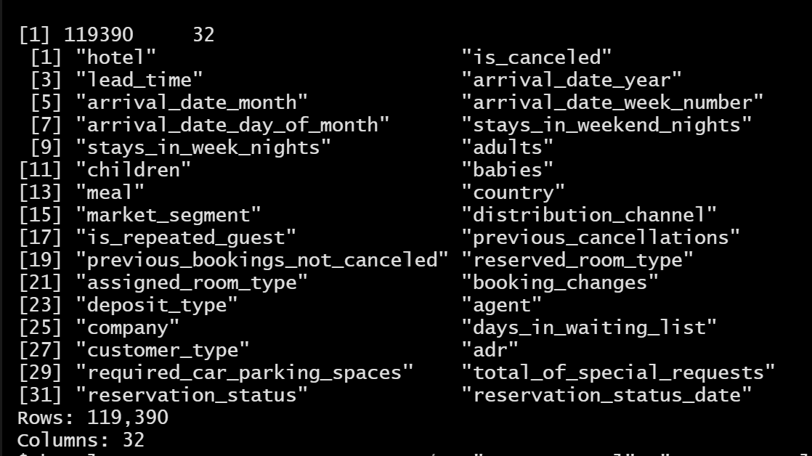
Variable Selection
Other variables
Special_requests
Hotel_type
Lead_time
Previous_cancellations
Hypothesis of variables
Notes:
Other variables we thought were not necessarily as useful: number of required parking spaces, arrival
We selected these variables as we believed that they would be strong indicators that would influence hotel booking cancellations.
Come with the presumption that these variables will be significant throughout the logistic regressions that we will perform.
We excluded previous bookings not cancelled because the majority of values were o, with only a handful of observations having a value greater than zero. We also thought there would be an issue between previous cancellations and previous bookings not cancelled.

Slide 6
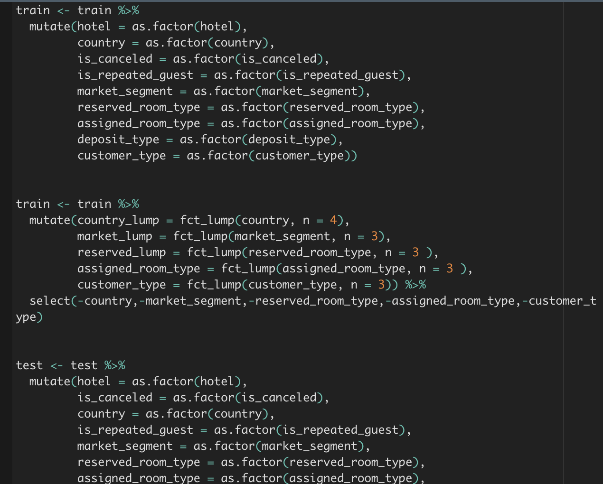
Cleaning Process
Created train and test models
Removed na’s (not many)
Changed variables to factors (fct).
Fct lumping (Ex. Country - Spain France, Portugal, Other_
Assigned_room_type (A, E, D, Other)
Removed assigned_room_type to avoid multicollinearity with reserved_room_type.

Slide 7
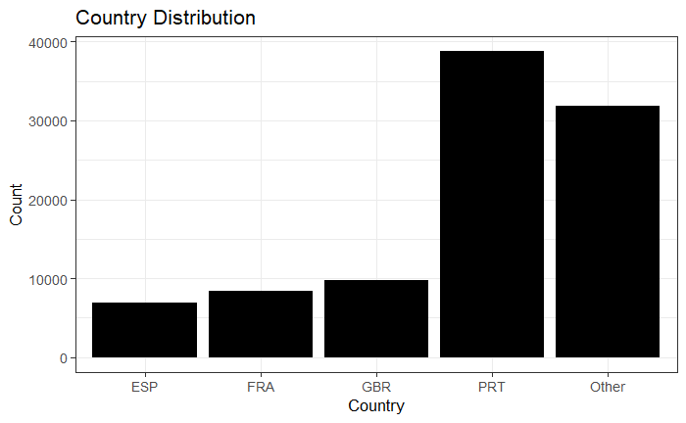
Country Visualization

Slide 8
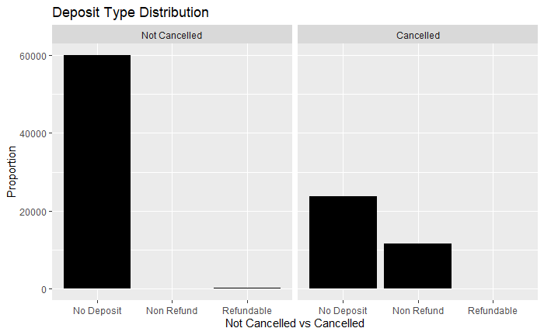
Deposit Type Distribution by Cancellation
Notes:
**seem that no deposits more likely don't cancel
Write proportion.

Slide 9
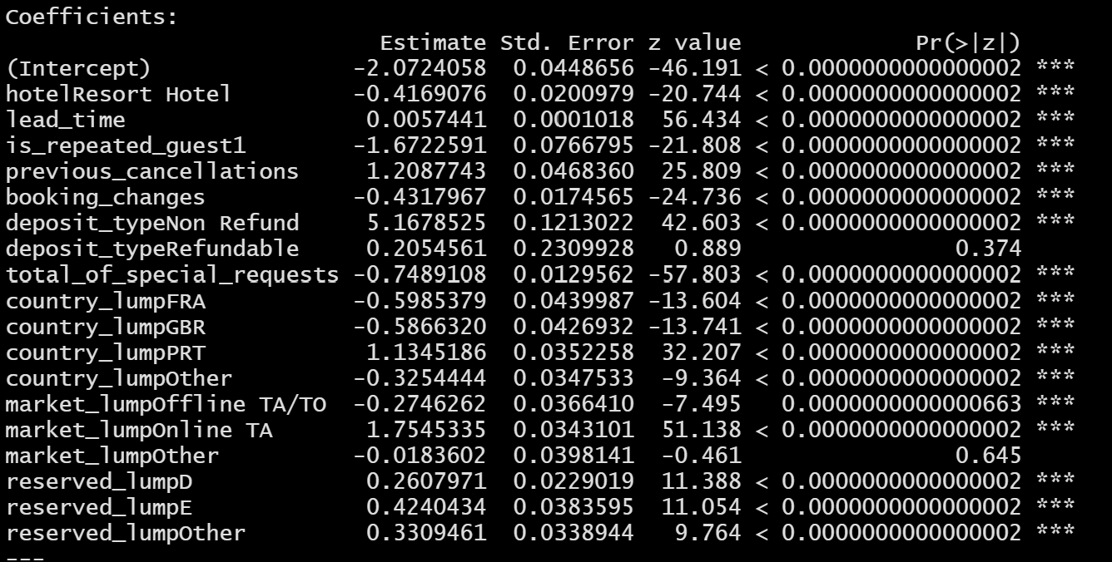
Logistic Regressions
Notes:
Two variables with a high P=value. We decided to keep them in because although our model is not perfect, it is a good model.
Low Std. Error

Slide 10
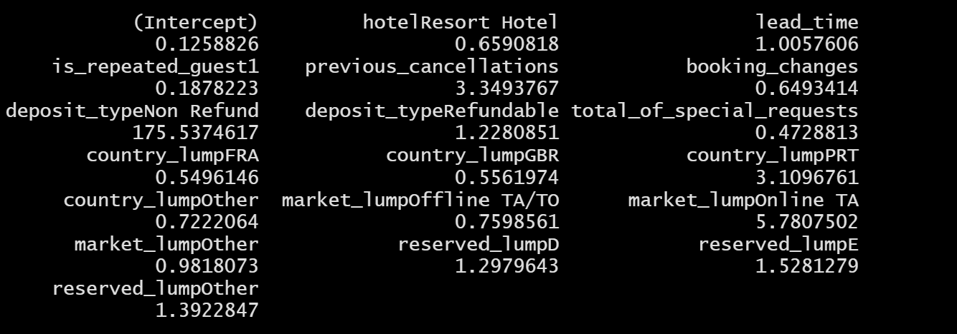
Logistic Regressions (cont.)
Notes:
Deposit_TypeRefundable, Previous_cancellations, Reserved_lumpOther, Deposit_typeNon Refund, Reserved_lumpD, Market_lumpOnline TA, Country_lumpPRT, lead_time.
Exponentiate the coefficients, tells us the impact of the variable on the unlogged odds ratio.
We can see some high coefficients. Deposit_typeNon Refund has one that’s very high. We attribute this, in part, to the high P-Value we had earlier.

Slide 11
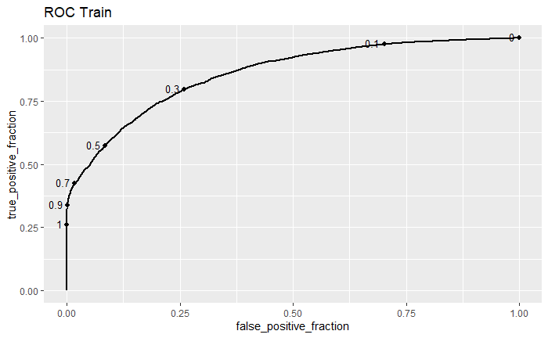
Logistic Model: Predictions & ROC Curves
Notes:
-AUC .85 = pretty good
-0.5 we have around 50% true cutoff point.
0.3 we have around 75%
Predicted for both train and test.

Slide 12
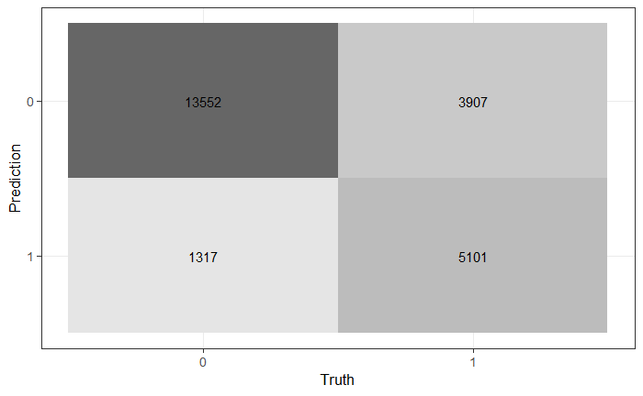
Logistic Model: Confusion Matrix
Notes:
Accuracy: 0.7812120
Sens: 0.9114265 - True Positive Rate. True Positive. Says that they cancel and they do.
Spec: 0.5662744 - True Negative Rate. False Positive. Says that they cancel but they don’t.
Bal_accuracy: 0.7388504 Sensitivity measures how often a test correctly generates a positive result for people who have the condition that’s being tested for (also known as the “true positive” rate) Specificity measures a test’s ability to correctly generate a negative result for people who don’t have the condition that’s being tested for (also known as the “true negative” rate).

Slide 13
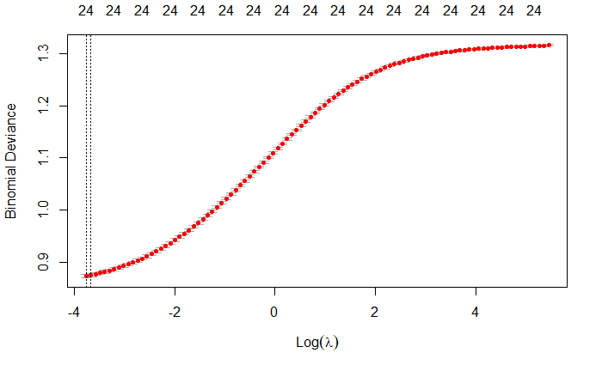
Ridge Mod
-Lambda value
-Binomial Deviance
-Variable Importance
Notes:
Ridge mod implies that a lot of variables matter a little.
The value of lambda here must be low to minimize error, which would mean we don’t have as a strict of regularization
When applied to logistic models, Ridge and Lasso models measure binomial deviance instead of CV loss. It’s a similar metric. It measures goodness-of fit, with higher numbers meaning a fit that is not as good.
This model doesn’t allow us to find the more important variables and filter out variables that don’t matter as much.

Slide 14
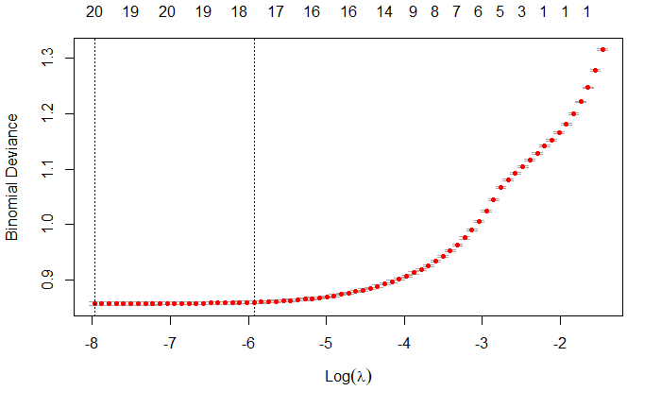
Lasso Mod
Notes:
Mod implies that only a few variables matter a lot.
Here we can see that even with a lower lambda, we can reduce our our variables from 24-20. If use a larger lambda value, we can still minimize our binomial deviance. It would appear then that we could use a lasso mod with some success.

Slide 15
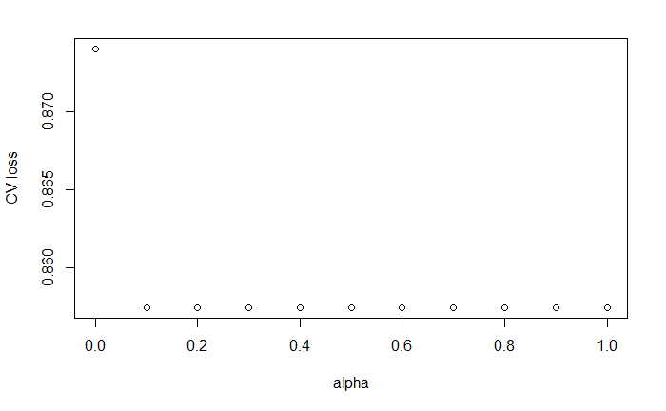
ElasticNet Mod
Optimal Alpha
Notes:
cva.glmnet will estimate a variety of elasticNet models varying alpha from 0 (all ridge) to 1 (all lasso).
0 - ridge, 1 - Lasso
Best_mod - 1.
Meaning Lasso is the best mod.

Slide 16
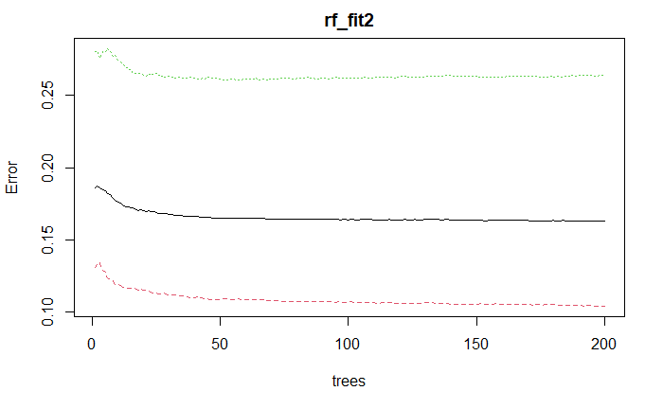
Random Forest:
Notes:
Here we can see that our error tapers off after about 100 trees. We could have done more, but the computational expense of this would not have been the worth the gain.

Slide 17
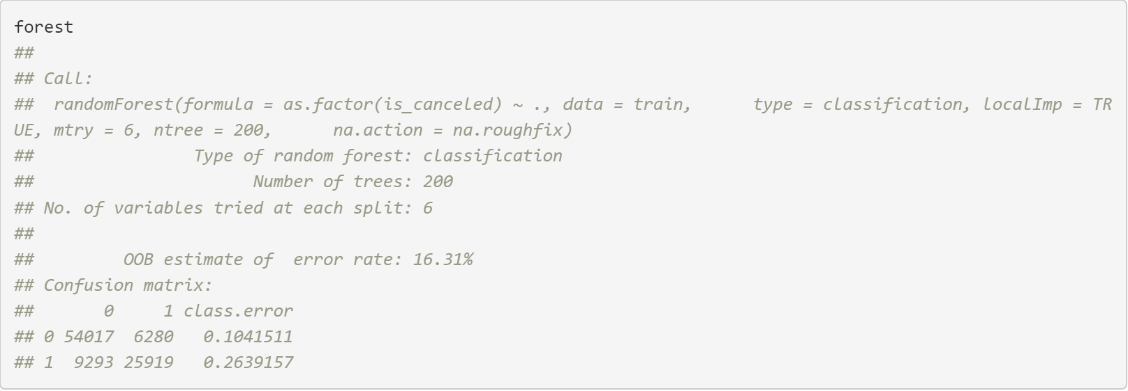
Random Forest: Confusion Matrix
Notes:
-From our random forest printout, we got this confusion matrix. Overall, we would see have a fairly decent out of bag error rate with 16.31%. Of course, we would want to decrease this error rate however we can. We found the best value of mtry to be 6, as that had the lowest oob estimate. We can see the error rates to be 10% and 26% respectively. Depending on the

Slide 18
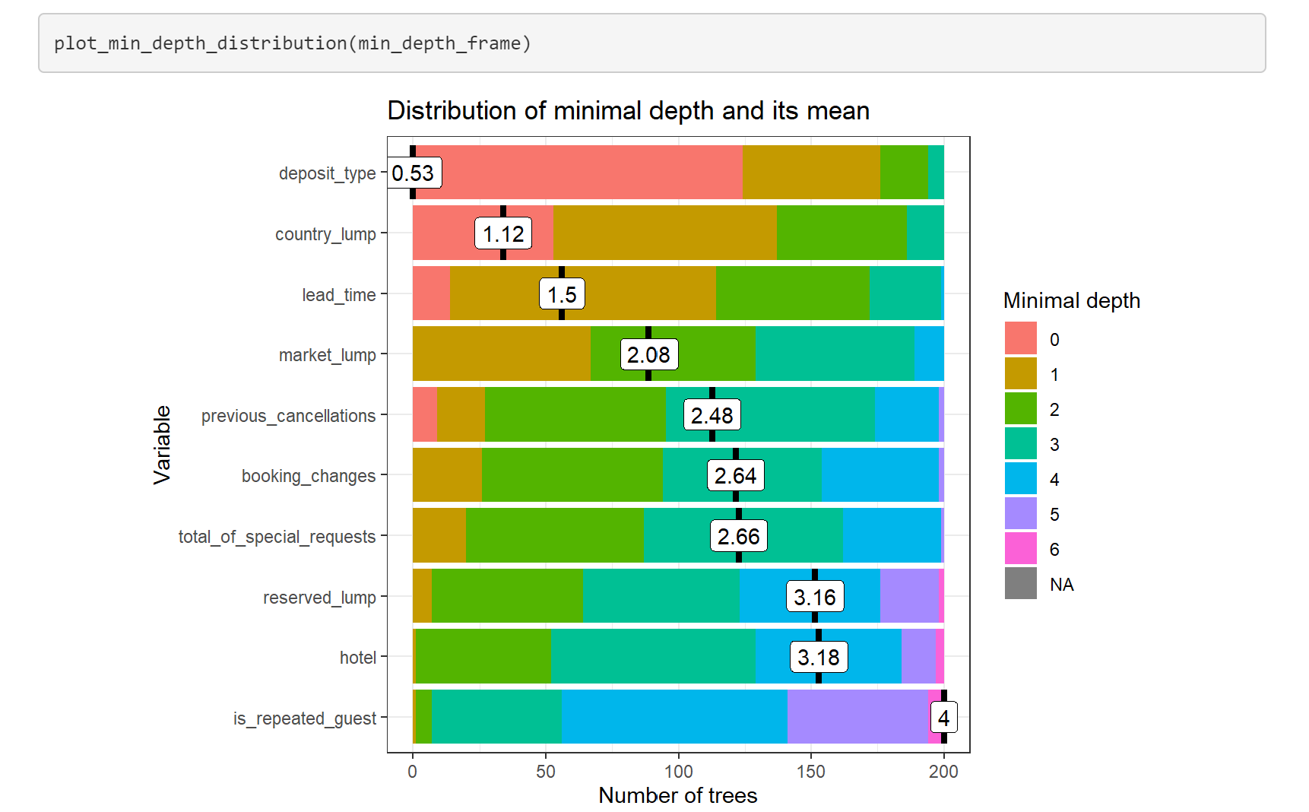
Random Forest: Minimal Depth Distribution
Notes:
Min_depth_distribution shows that we can explore all the individual models that comprise the random forest.
The plot_min_depth_distribution function shows that depost_type has the highest average position in the trees at a 0.53.
Meaning half of the time it’s the first split at split 0).
While, country_lump, lead_time and market_lump are the next important variables to influence hotel booking cancellations.
Looking at this data, it would make sense that the deposit type, country from where you’re coming from, lead time are all indicators that can lead to a potential hotel booking cancellation.

Slide 19
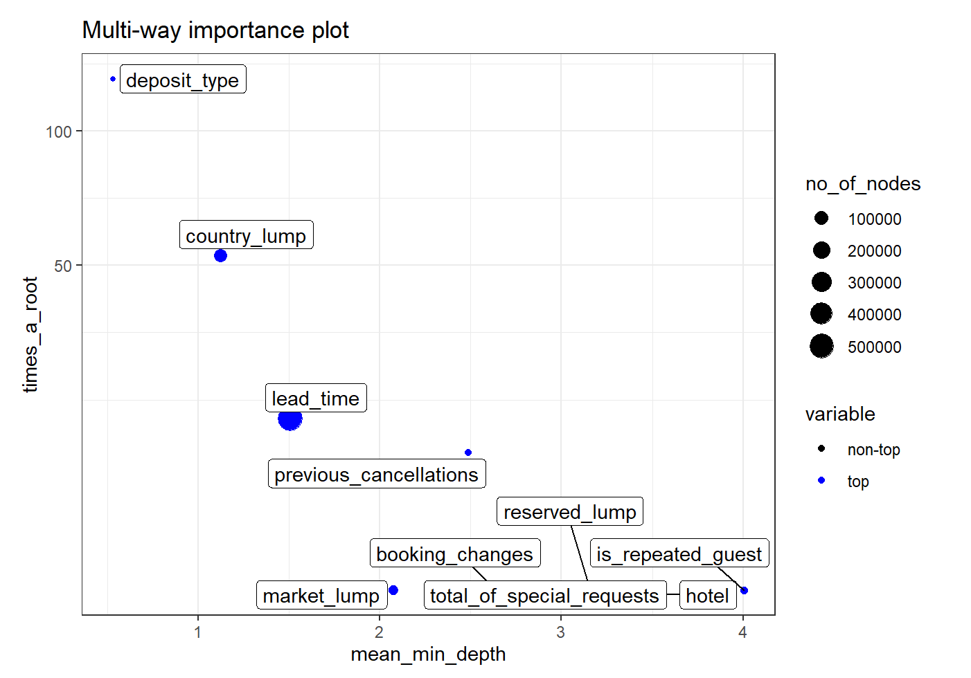
Random Forest: Multi-Way Importance
Notes:
We can see information on how many times each variable is a root against the mean depth for each variable. (plot_multi_wy_importance.
Consistent with minimal depth distribution, has greater average depth.
Deposit_type, country_lump, lead_time and previous cancellations might be a useful grouping of variables.

Slide 20
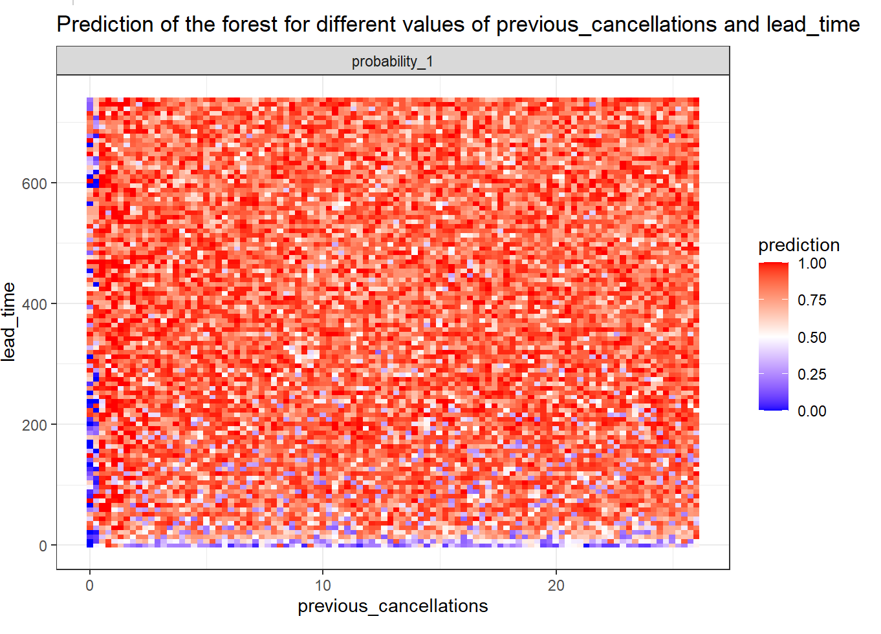
Random Forest: Interactions
Notes:
As shown, we can see that a increase in lead_time can lead to a decrease in previous_cancellations.

Slide 21
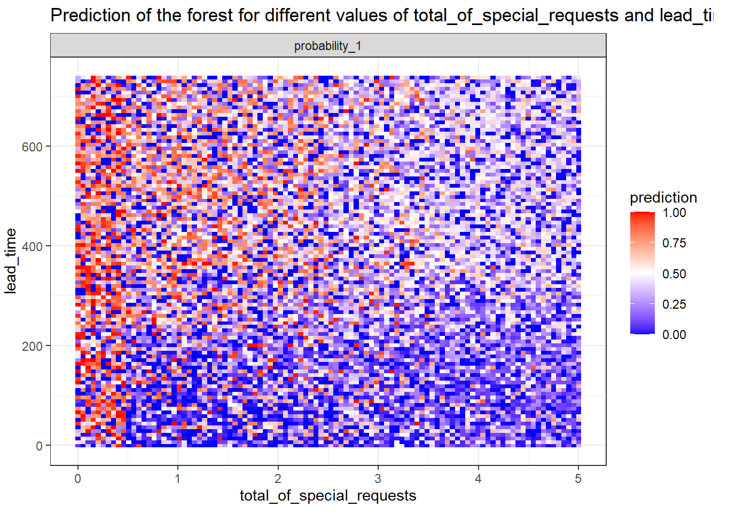
Random Forest: Interactions
Notes:
More special requests suggests that there would be less cancellations.
Also, a increase in lead_time suggests that there would be less cancellations.

Slide 22
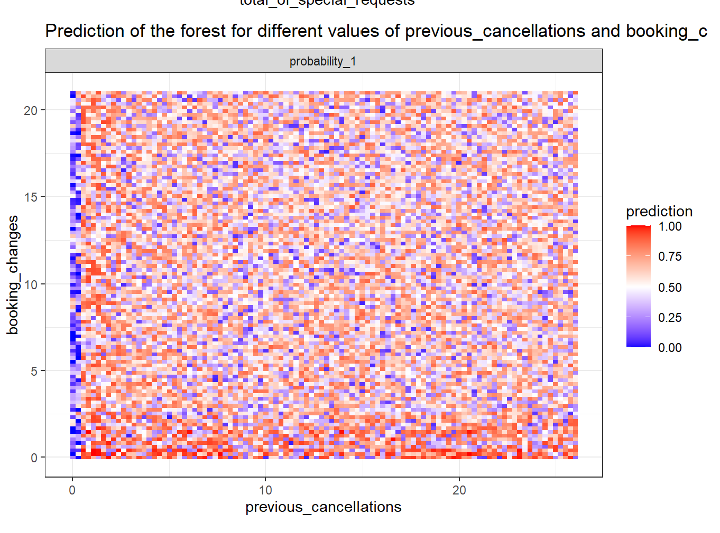
Random Forest: Interactions
Notes:
-Fewer (if any) previous cancellations means a greater likelihood of not cancelling, even with more booking changes.

Slide 23
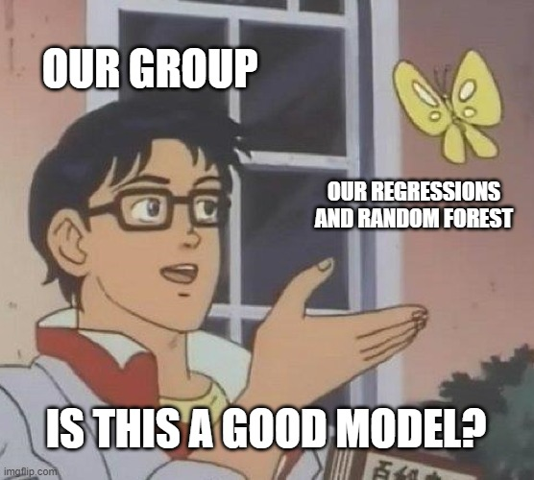
Model Conclusions
Logistic model=simple
Ridge model=no variable selection
Lasso model= lowest binomial deviance
ElasticNet=use Lasso
Random forest=low OOB error
Best choices?
Notes:
Logistic model = simple model, high true positive rate at the expense of lower true negative rate, with decent accuracy
Ridge model didn’t allow us to have select variables, and also had a small coefficient for lambda.
Lasso model = lowest binomial deviance. Best model, since small amount of variables matters a lot.
Random forest has greater accuracy and low oob error, but is a little less interpretable. Depending on scope and application, this may be overkill
Overall, we would recommend either the lasso model or the random forest, the trade off being interpretability

Slide 24
Model Accuracy
Choosing best model?
Balanced model
Simplicity vs complexity
Explainability
Scope
Constraints

Slide 25
Future Steps and Considerations
Lasso mod predictions
Random Forest predictions
Additional Random Forests
Overfitting vs underfitting?
Multicollinearity?
Confounding variables?
Variable exclusion

Slide 26
Questions?

